Slide 1
Different variants of Gradient Descent
Name:- Jimita Gandhi

Slide 2
Analysis of following Algorithms
We will implement different variants of gradient descent algorithm.
Gradient Descent
Momentum Gradient Descent
Nesterov Accelerated Gradient Descent

Slide 3
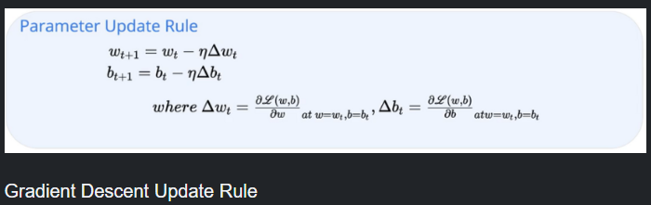
GRADIENT DESCENT Gradient descent algorithm updates the parameters by moving in the direction opposite to the gradient of the objective function with respect to the network parameters.

Slide 4
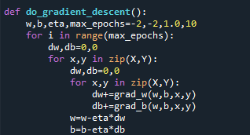
Gradient Descent Algorithm Implementation
OUTPUT :-
gradient descent
weight
-1.5774501955157159
bias
-1.5113776269351704
error
13.407020472418889

Slide 5
Momentum Gradient Descent
In Momentum based GD, we have included the history variable to keep track of the values of previous gradients.
The variable gamma denotes the how much of momentum we need to impart to the algorithm.
The variable v_w and v_b will be used to compute the movement of the gradient based on the history as well as the current gradient.
At the end of each epoch, we are calling the prev_v_w and prev_v_b function to store the history of parameters and loss function values.
Update rule for momentum based gradient descent
update_{t} = γ · update_{t−1} + η∇w_{t} w_{t+1} = w_{t} –update_{t}

Slide 6
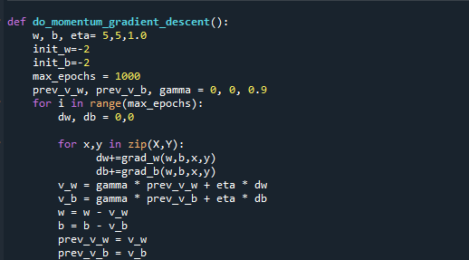
Momentum based Gradient Descent Algorithm Implementation
Momentum based Gradient Descent Algorithm Implementation
OUTPUT :-
momentum gradient descent
2weight
5.072274394304259
2bias
-3.9235350682640973
error
6.504984297202142

Slide 7
Nesterov Accelerated Gradient Descent
In Nesterov Accelerated Gradient Descent we are looking forward to seeing whether we are close to the minima or not before we take another step based on the current gradient value so that we can avoid the problem of overshooting.
Update rule for NAG
w_{look ahead} = w_{t} − γ · update_{t−1}
update_{t} = γ · update_{t−1} + η∇w_{look ahead}
w_{t+1} = w_{t} − update_{t}

Slide 8
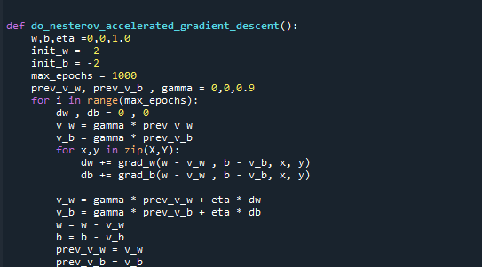
Nesterov Accelerated Gradient Descent Algorithm Implementation
OUTPUT :-
nesterov accelerated gradient descent
weight
137.12499961674337
bias
16.49999923348712
error
6.825

Slide 9
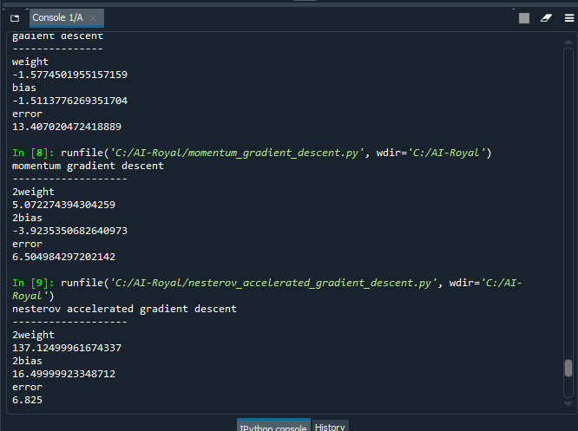

Slide 10

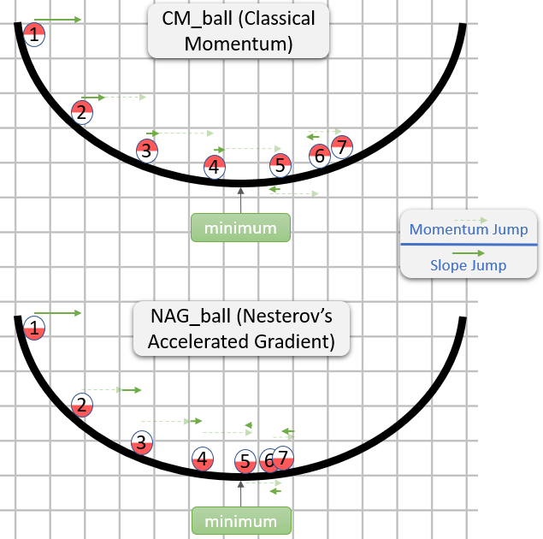
As the example shows the difference between momentum GD and NAG.
In the regions having gentle slopes, momentum based gradient descent is able to take large Steps because the momentum carries it along and chances of escaping from min valley is more.
In nesterov oscillations are smaller and the chances of escaping the minima valley also smaller and chances are also less to cross our region

